Slide 1

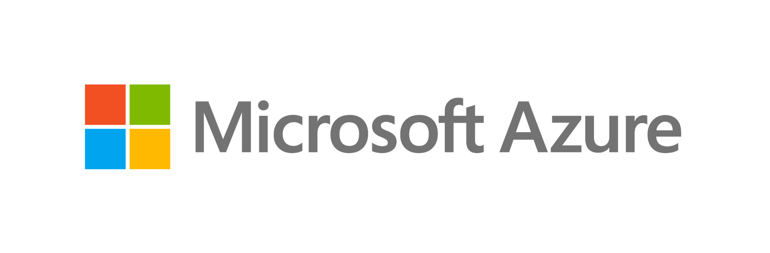
Bank of Baroda Hackathon - 2022
Technology Partner
Your Team Name : Dynamic Energy
Your team bio : 1.M.Swetha - 3rd year, ECE Dept
2.A.Veroni divya - 3rd year, ECE Dept
Date : 06.11.2022

Slide 2
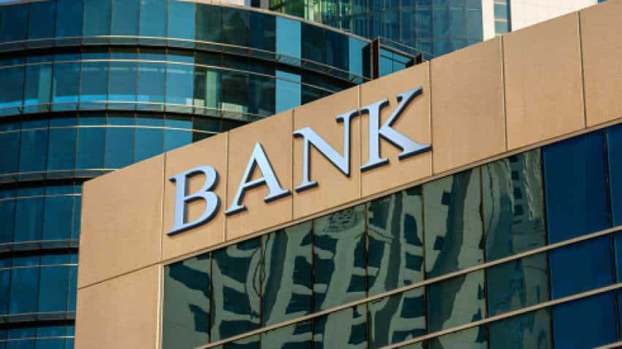
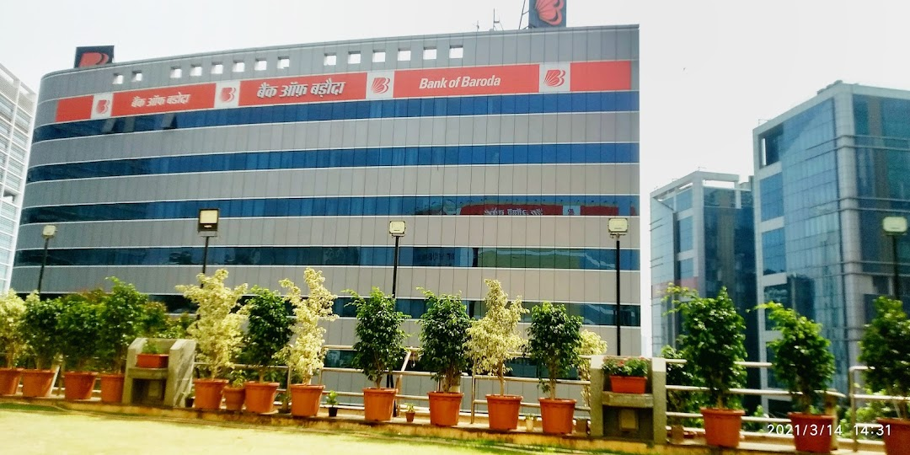
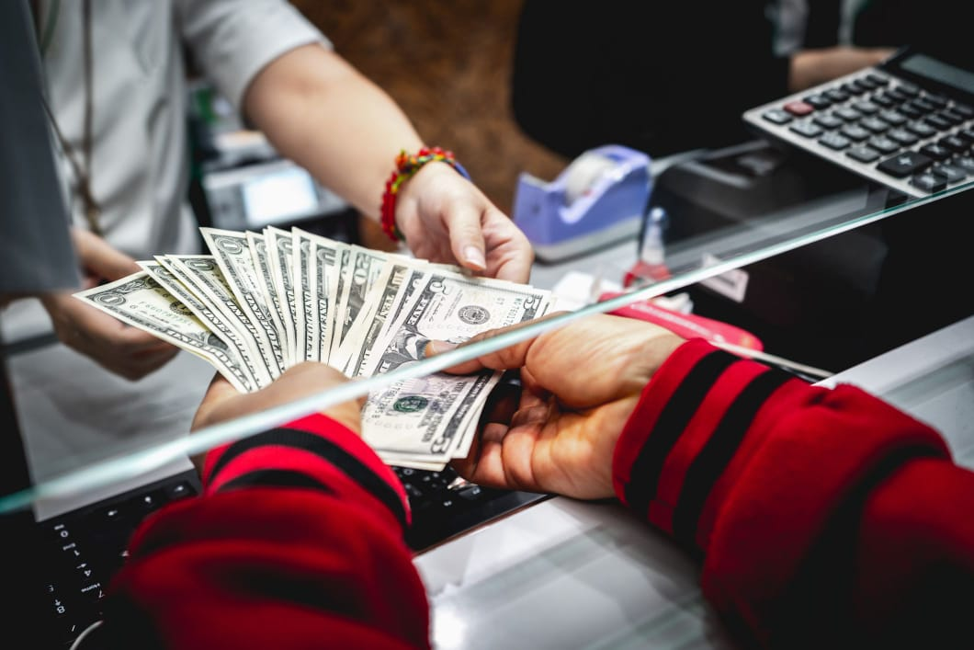
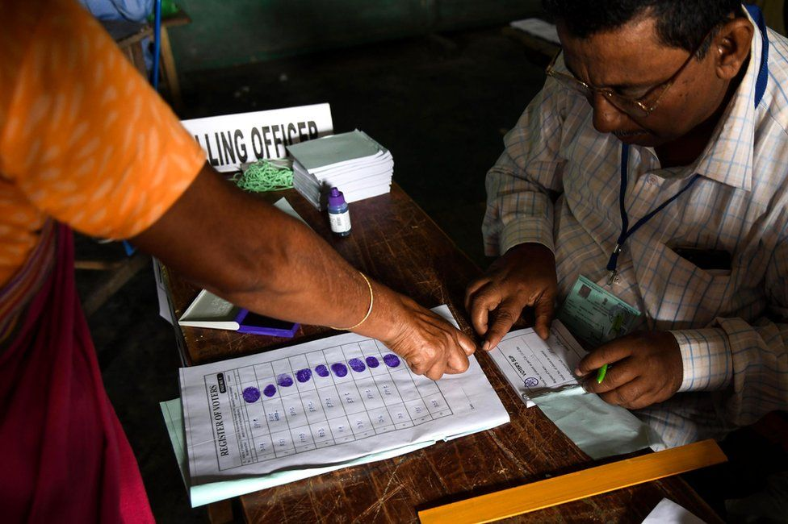
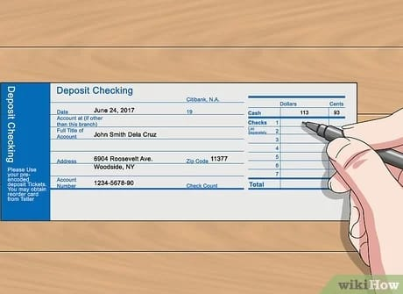
Problem Statement?
PSU banks is set to open about 300 branches in unbanked areas by December 2022.
There are many branches of Bank Of Baroda all over India.Their branches are in rural areas also.
We all know about the importance of banks. Though digital transactions are possible today, still we need banks for depositing money, enquiries etc..
Not everyone is educated. Illiterate people feel uncomfortable since language is a barrier while filling forms and communicating with the officers.
Few forms might get missed while filling them manually.

Slide 3
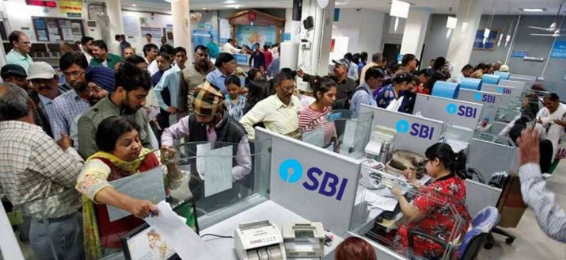
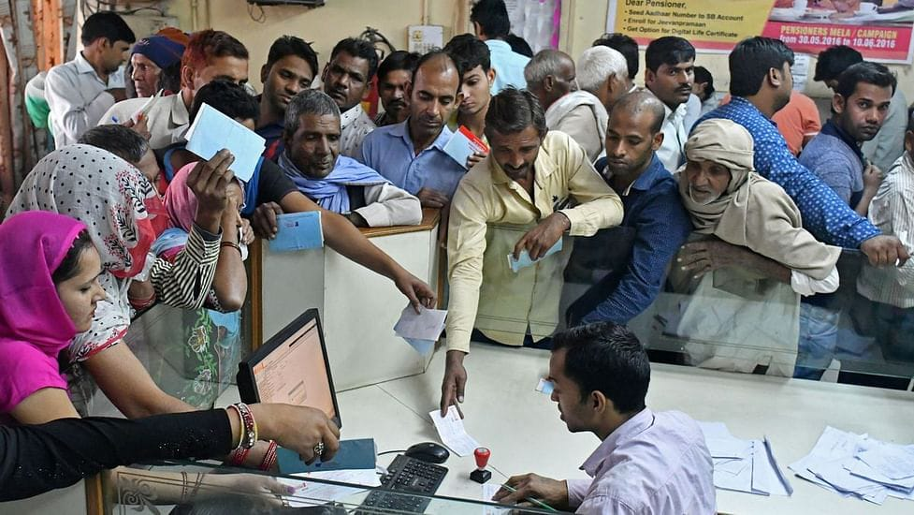
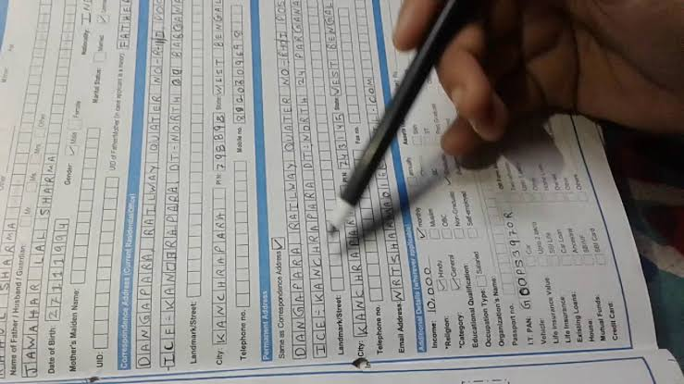
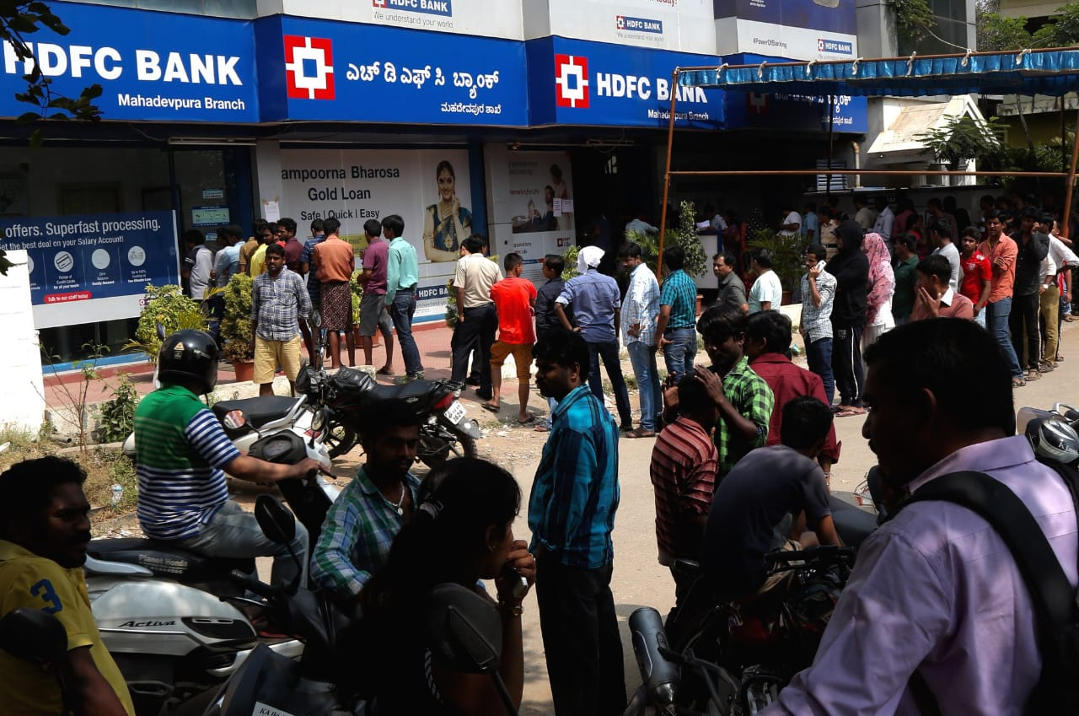
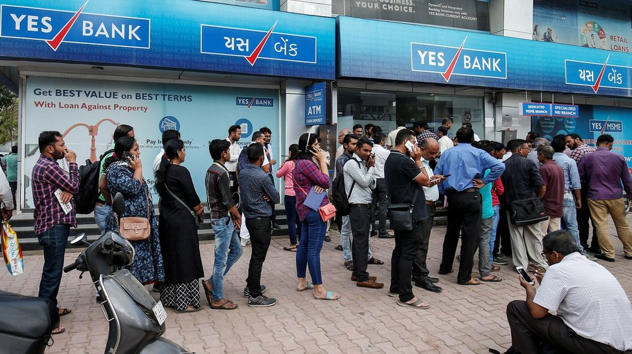
User Segment & Pain Points:
Bank Customers would be Early Adopters of our product.
Increased Work pressure of Bank OffIcers
Language will be the Barrier while filling forms in Bank for Uneducated people.
The Officers need to verify the forms filled by customers in long queues.
Waste of Time for Customers

Slide 4
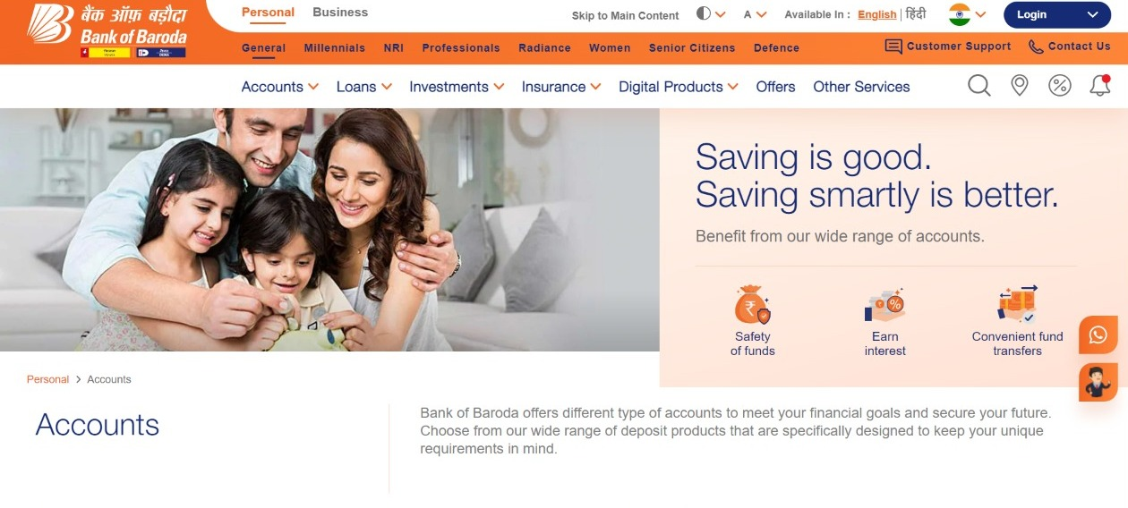
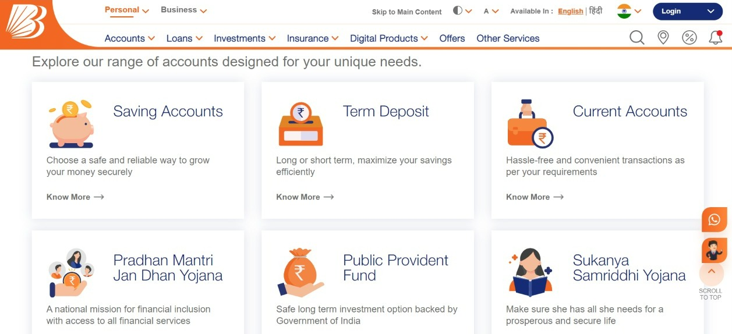
Pre-Requisite:
Digitalized Account Opening
Digitalized Banking Schemes
Opening an Account and filling forms manually in banks.

Slide 5
Azure tools or resources:
1. Microsoft Bot Framework
2. Visual Studio Code
3. Visual Studio.web network
4. .NET Framework Runtime 4.6.1
5. Cognitive Services
6. Speech SDK
7. TTS - nodejs
Programming Languages used:
1. HTML
2. CSS
3. Javascript
4. Python
Tools other than Azure:
1. Python 3.7.3
2. Wondershare Demo Creator
3. Installation of languages other than
English in Windows11
4. Few Python Libraries

Slide 6
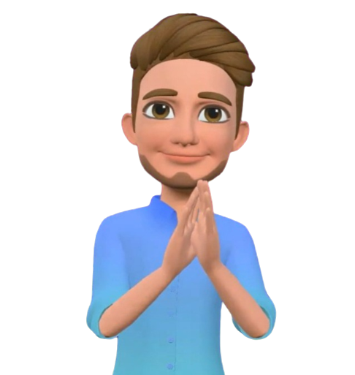
Outline of the Proposed Work:
Sam is the Virtual Avatar who assists the Customers in Opening an account, form filling etc..
Sam speaks to the Customer and asks about the need of him/her.
After listening to the reply of the Customer, Sam opens the respective form to be filled in the language chosen by them in the display screen.
Sam questions the Customers about the details which are needed to fill the form.
Once hearing the answers from the Customers, Sam automatically starts typing the details in the respective questions, in the respective language.
This process repeats till the entire form is filled.
Signature, Photograph, Pan card, Aadhar card etc.. will be scanned by Sam through Camera.
After filling the entire form, Sam saves the filled form as a Document in the system and sends a copy to the e-mail Id given by the Customer.

Slide 7
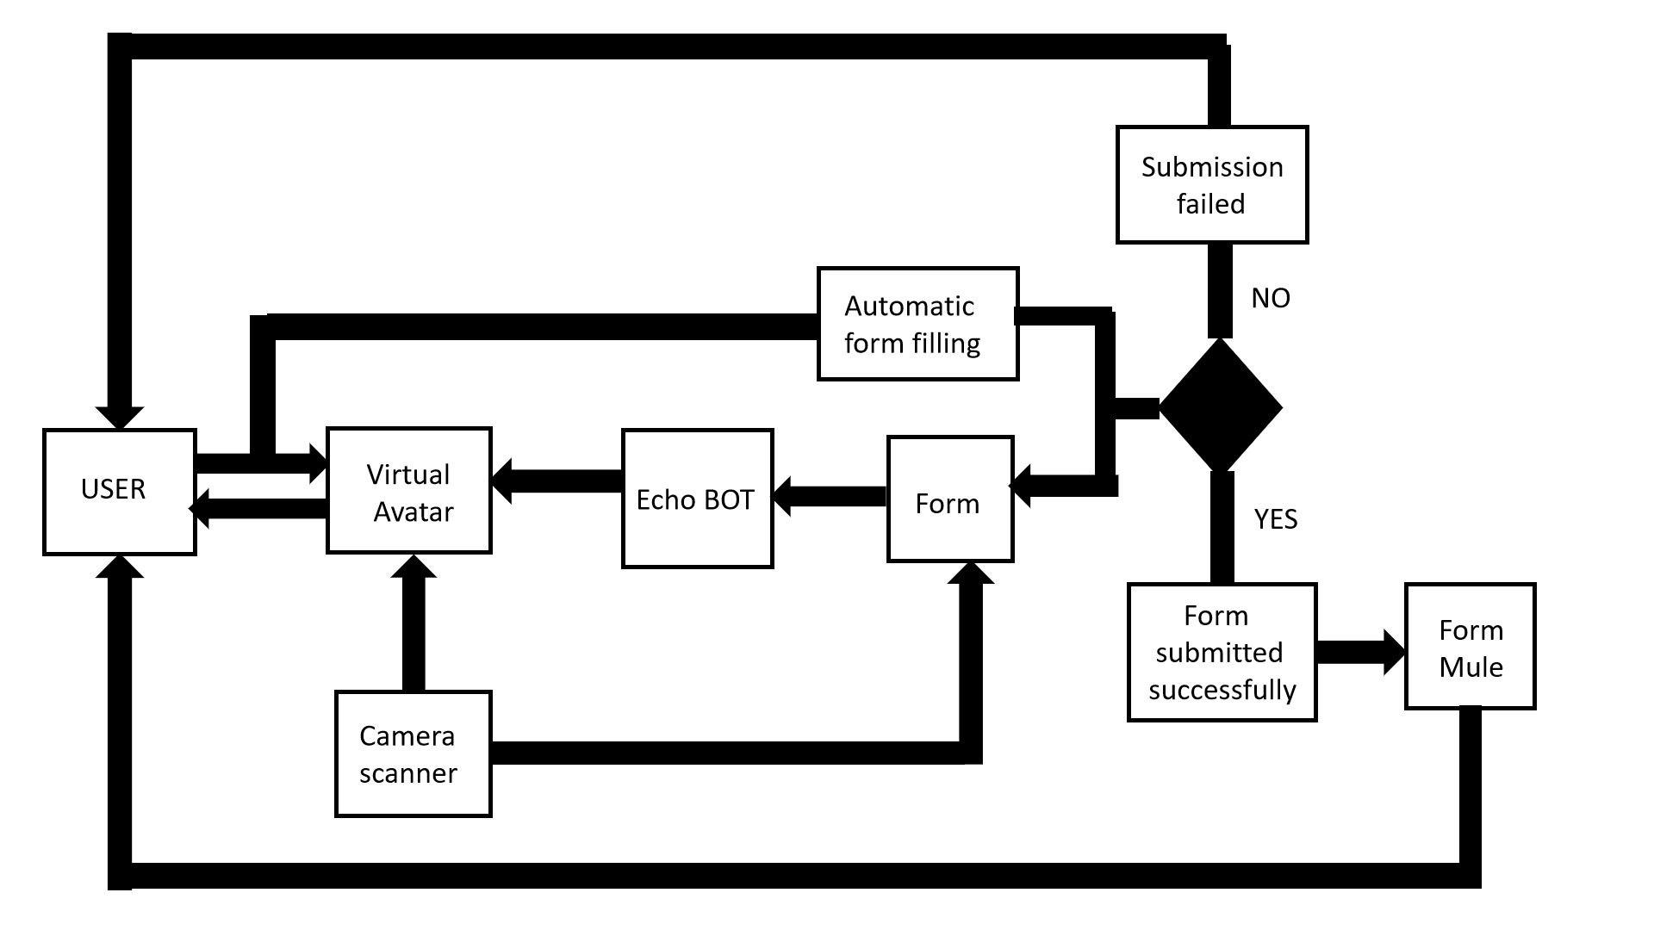
Outline of the Proposed Work:

Slide 8
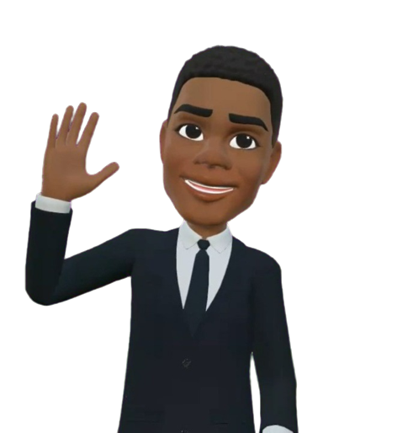
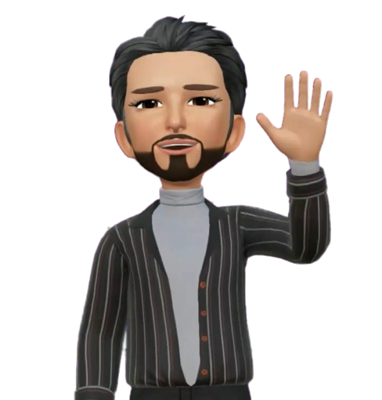
Module 1 - Virtual Avatar:
Since the Use case chosen by us is “Virtual Avatar”, we implemented this as our 1st Module.
Our Virtual Avatar is Sam.
Sam can speak in 3 different languages – English, Tamil, Hindi.
Sam also changes his costumes according to the language chosen by the user.
Sam was created using WonderShare Demo Creator.
On installing this software, we can create our own characters like Sam.
Costumes of Sam were also changed there.
On switching on the camera, we can perform actions that will be recorded.
Later, Sam will be created using our face and features.
Then, Sam was attached to the respective forms in the respective costumes.

Slide 9
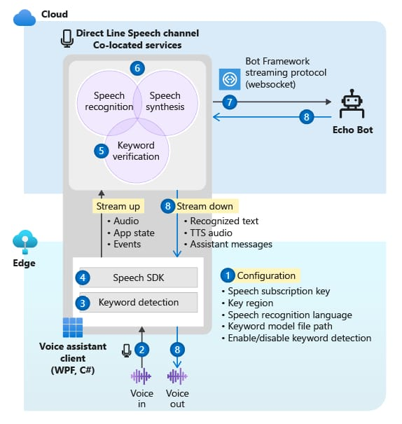
Module 2 - Voice Bot:
The sample client application is configured to connect to the Direct Line Speech channel and the echo bot.
When the user presses a button, voice audio streams from the microphone. Or audio is continuously recorded when a custom keyword is used.
If a custom keyword is used, keyword detection happens on the local device, gating audio streaming to the cloud.
By using the Speech SDK, the sample client application connects to the Direct Line Speech channel and streams audio.
Optionally, higher-accuracy keyword verification happens on the service.
The audio is passed to the speech recognition service and transcribed to text.
The recognized text is passed to the echo bot as a Bot Framework activity.
The response text is turned into audio by the text-to-speech service, and streamed back to the client application for playback.
This Voice Bot is attached behind Sam.

Slide 10
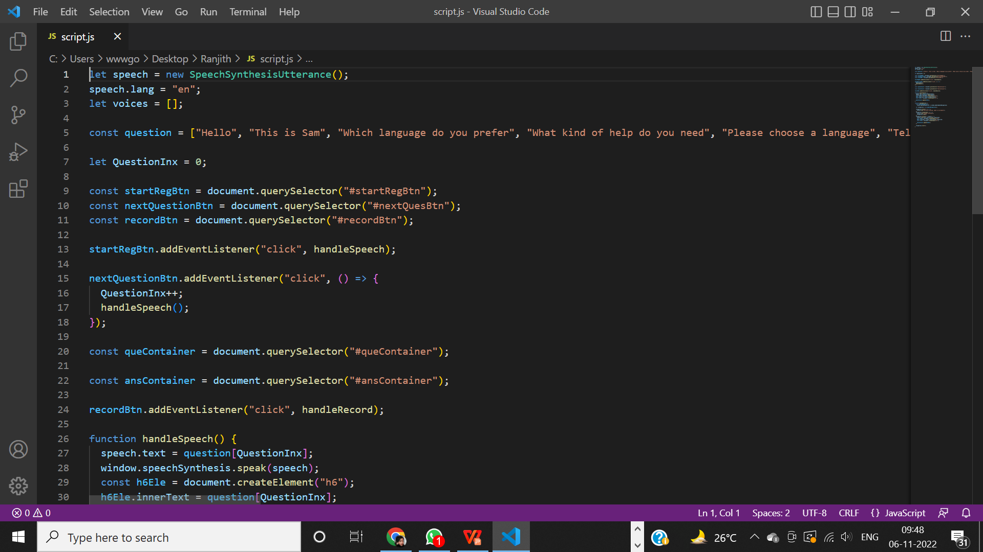
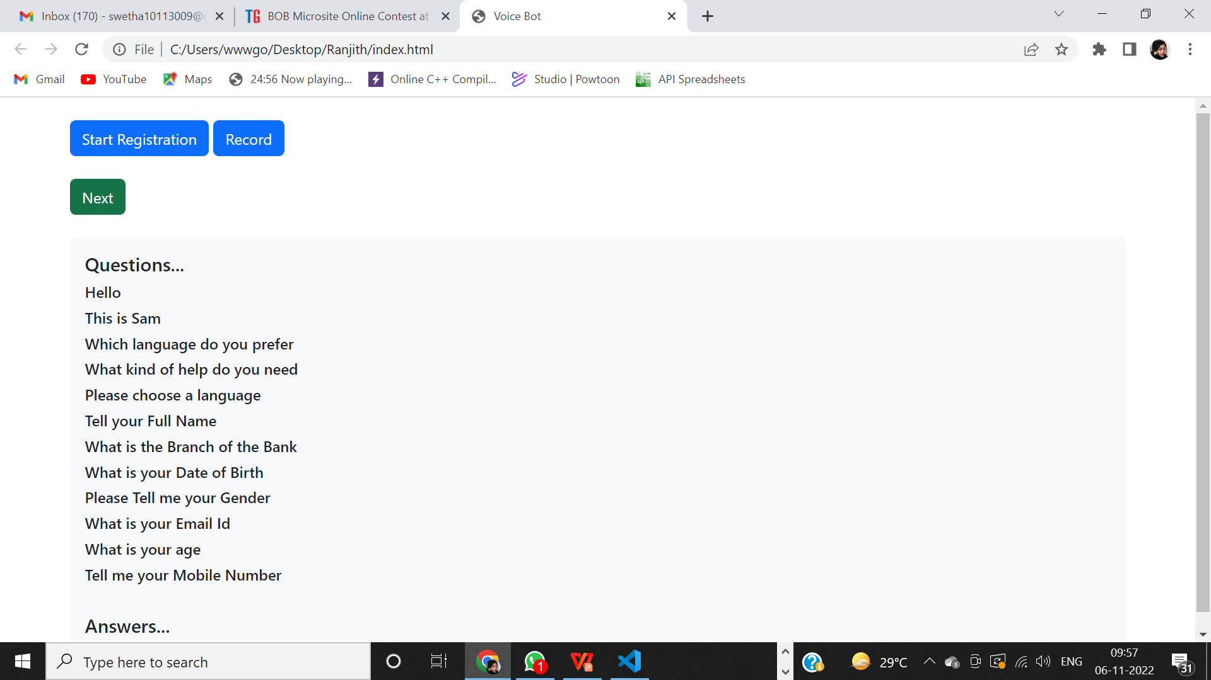
Module 2 - Voice Bot:
Feeded Javascript Code
Output

Slide 11
Module 3 – Account opening form(Example):
The Account opening form is created by us for the prototype.
This form is created using HTML in Visual Studio Code.
The basic details asked in the form created by us are as follows:
Language – To be chosen to fill the form in their native language.
Branch
Full Name, Last Name, Initial
Date of Birth
Gender
Mobile no.
Country
Email id
Address
Photo copy
Aadhar No.
PAN No.
Signature
Submit option gets activated, when the entire form is filled.
Reset option gets activated for the next user.

Slide 12
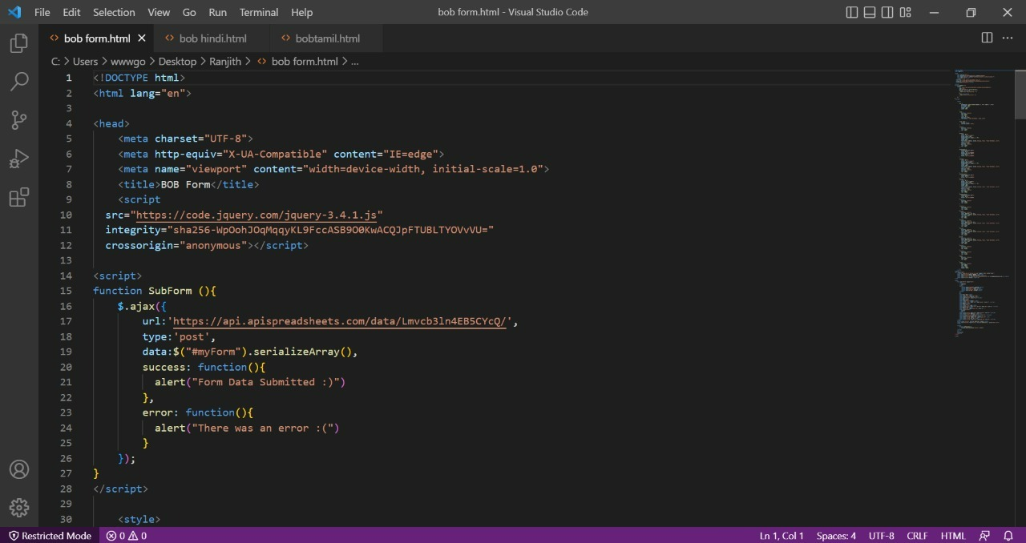
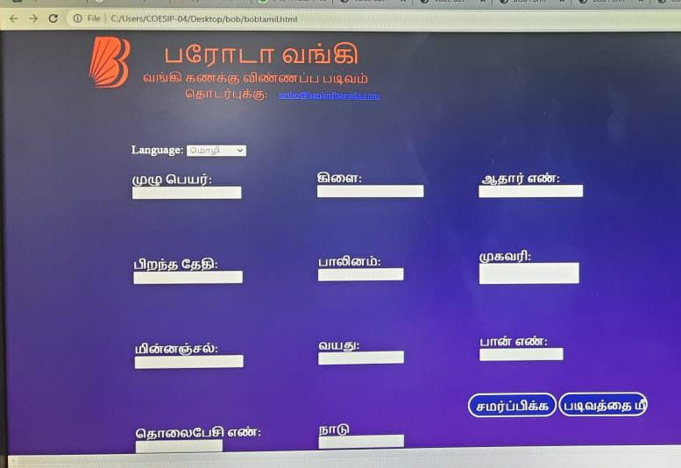
Module 3 – Account opening form(Example):
Feeded HTML Code
Output

Slide 13
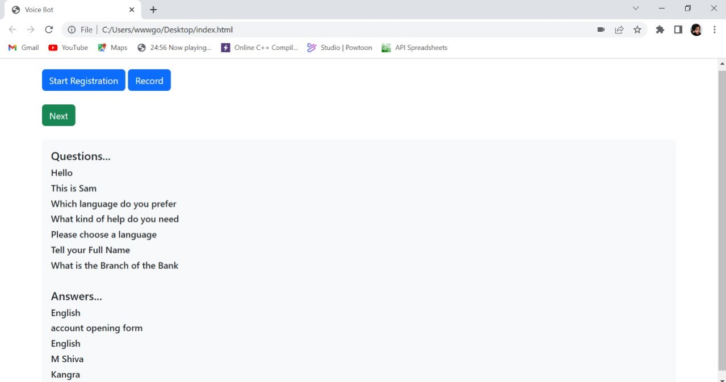
Module 4 – Interaction between User and Virtual Avatar:
Sam greets and interacts with the user.
First of all, Sam asks the user to choose a language to interact.
Then, he asks for what kind of help he could offer.
On the selection of the type of form, Sam opens the respective digital form to be filled.
Sam asks the user about all the details asked in the digital form.
The form gets automatically filled as soon as the user replies.
On the completion of the form, Sam turns on the Camera.
He will ask the user to show the KYC Documents of the user infront of the Camera to scan.
After scanning, Sam tells the user whether the form is successfully submitted or not.
Then he wishes the user to see him again.

Slide 14
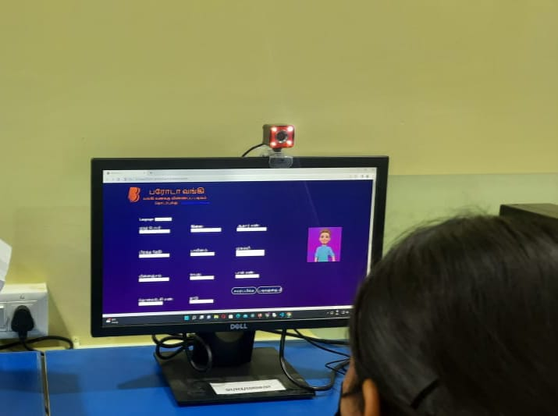
Module 4 – Interaction between User and Virtual Avatar:

Slide 15
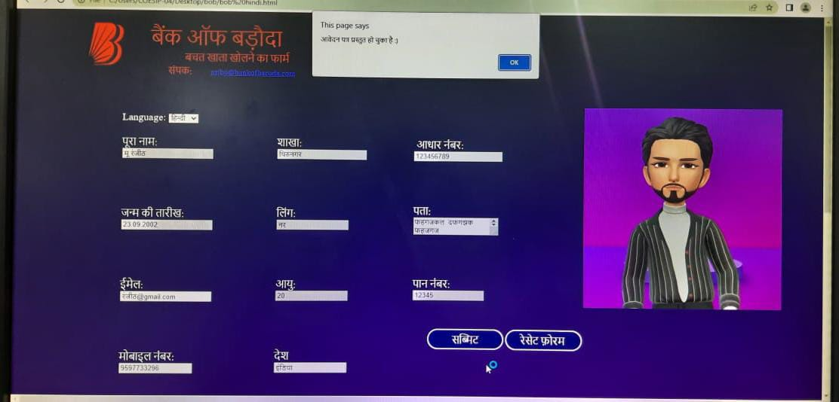
Module 5 – Automatic Filling of Form:
The Voice Bot behind the Virtual Avatar receives the answers from the user.
The Client and Server are connected using API Connection.
API Connection is achieved by Nodejs, Expressjs, MySQL, Reactjs.
Now, the answers are sent to the Server.
The Server stores the Answers in the Data Base.
Then it is sent back to the form by server for autofilling.

Slide 16
Module 6 – Scanning of KYC Documents:
The KYC Documents are:
PAN Card
Aadhar Card
Passport
Driving License
Voter’s Identity Card
Using Python codings, we make the Camera turn on automatically.
Sam asks the user to show the KYC Documents in front of Camera.
The Camera records and store the video along with the Form.
The recorded video will be mailed to the user along with the form after completion.

Slide 17
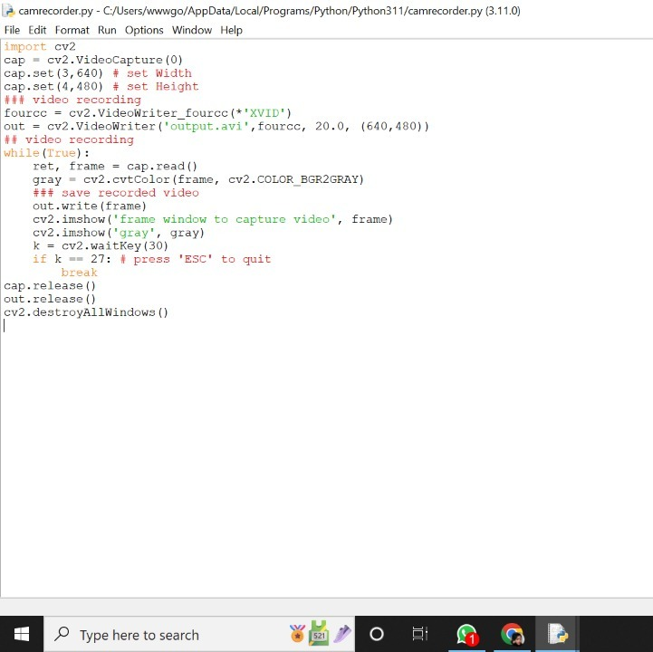
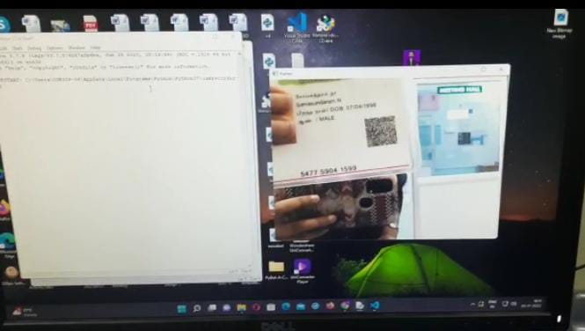
Module 6 – Scanning of KYC Documents:
Feeded Python Code
Output

Slide 18
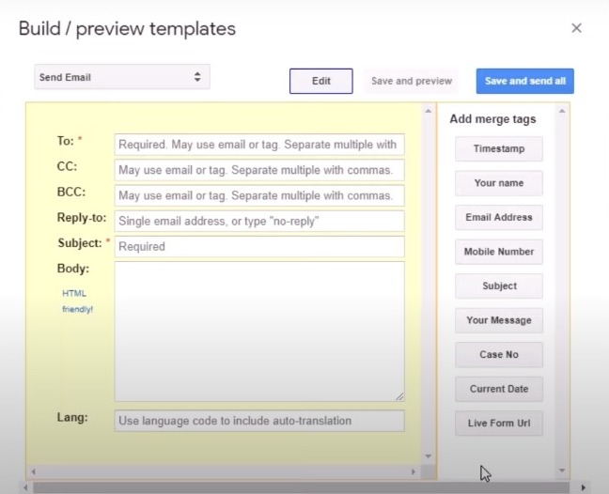
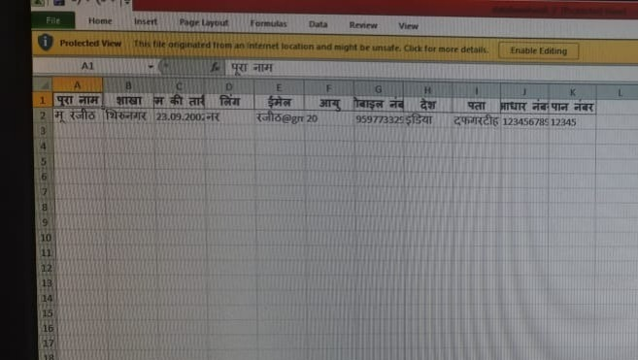
Module 7 – Transfer of filled form via mail to User:
The Automatically filled form will be sent to the user via mail.
The user details will be stored in the respective Excel sheets.
We installed Form Mule in the Add ons option in the Excel sheet.
Then, Form Mule Setup was made.
Using HTML, we gave Bank’s Mail Id as From address and made the user’s Mail Id as To address.
The entire filled form was made default to be entered into the body of the mail using HTML.
Thus, the entire filled form will be sent to the user via mail.

Slide 19
Algorithms/Machine Learning Models:
The Machine Learning Algorithms implemented in our project are as follows
1. Speech SDK
2. Text To Speech

Slide 20
Key Differentiators:
EXISTING ALTERNATIVES | VIRTUAL AVATAR
Non existance of Virtual Avatar. | Sam is the Virtual Avatar who assists the Customers in Opening an account, form filling etc..
Though Digitalized Banking, Form filling are available, details has to be given as input through Keyboard. | Using Speech SDK, Customer’s voice is given as input to the system.
Officers communicate with the customers and the software or system does not. | Sam speaks to the Customers and replies to their queries.
Photograph is to be pasted in the form and KYC Identification Documents has to affixed along with the form. | Sam scans the Photograph, Signature and KYC Identification Documents through Camera.
The manually filled form can never be seen by the Customer again. | After the form is filled, it is automatically saved and sent to Customer’s E-mail id.

Slide 21
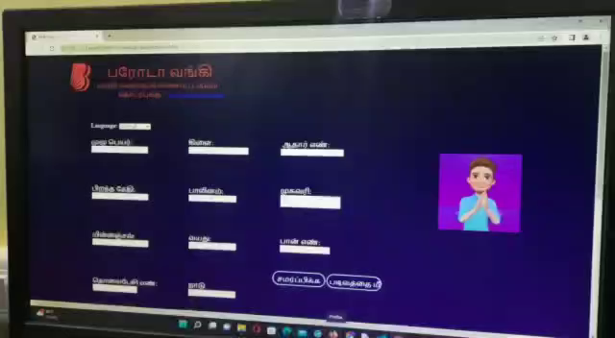
Demo Video:

Slide 22
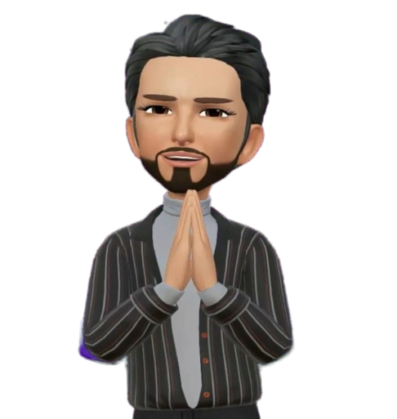
Marketing and Scope of the Work:
This Use case can be implemented not only in
Bank of Baroda but also in all the Other Banks.
This Project is mainly for Bank Customers and Employees.
Since this Virtual Avatar makes its Customer(Illiterate) comfortable in filling the forms for different bank uses, this could have a very good reach in all the banks.
This Virtual Avatar will have a successful Scope, since it supports multiple Indian languages.
This could also be implemented in mobile phones, tablets, laptops, pc etc... when we go for Digitalized Banking from our homes.
This is could be achieved on further development of the project.

Slide 23
Adoption Plan:
DURATION | WORK
15 days | Creation of Virtual Avatar
15 days | Echo Bot using Microsoft Bot Framework
15 days | Merging Virtual Avatar and Echo Bot(Voice assistant) and Testing
15 days | Scanning of KYC Identifications
The PoC can be setup in Microsoft Azure Cloud setup in 15 mins.

Slide 24
Why should you choose us?
We from team “Dynamic Energy” understand the societies problems deeply and accurately and make reasearches to propose solutions. And we work hard to transform our insights to actions. We have worked hard for the comletion of this prototype. We have made this Virtual Avatar - Sam to speak different Indian languages fluently. If a person who does not know to fill a form or if an illiterate comes to the bank, Virtual Avatar and the software created by us make them feel comfortable in filling the digitalized form. Digitalized forms are available in the Bank of Baroda website but it does not feature any Virtual Avatar and that form cannot be filled automatically. But we have made it possible and feasible.

Slide 25
Thank You
TEAM MEMBERS:
1. M.Swetha
2.A.Veroni divya
TEAM MENTORS:
1.Mrs.T.Ruba
2.Mr.A.Nagaraj

